Slide 1
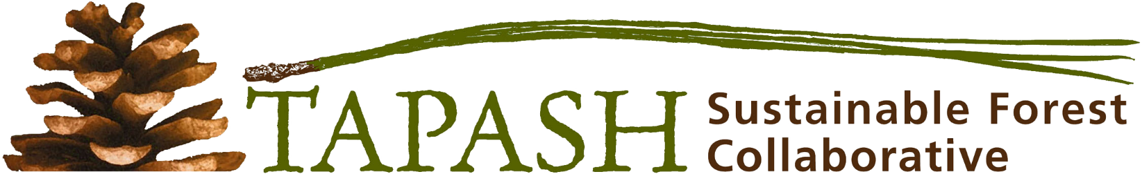
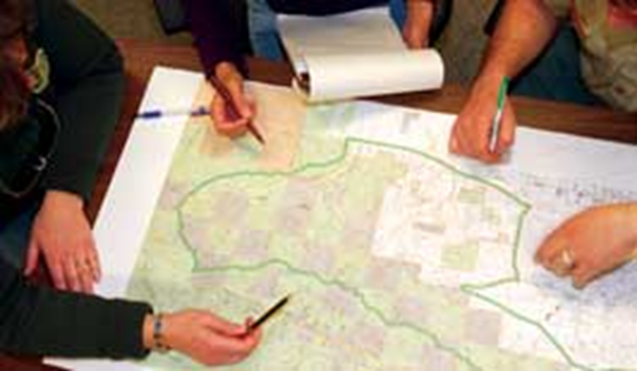
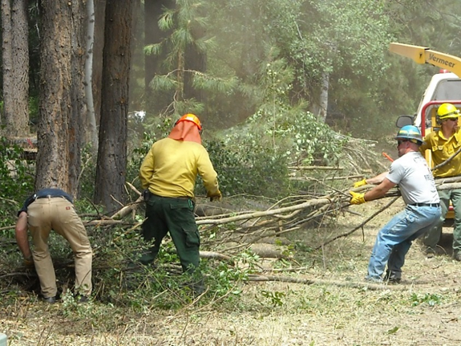
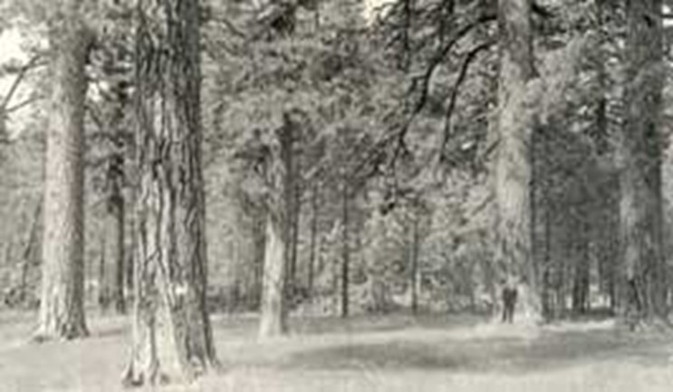
Táp’ash (n) pine tree. (Pinus) __ Imítichnik táp’ashyaw ánichatak
Stakeholders Meeting in Ellensburg Washington
April 21, 2017
Laura Potash, Tapash Coordinator
Notes:
I learned from Paul Ward, Yakama Nation Fisheries Prg Mgr Sahaptin word, accent first syllable pronounced Tupperware. In honor of the first people within the “Tup-ush” landscape.

Slide 2
Overview of today’s meeting:
Safety first
Thank you all attendees, speakers, and to today’s worker bees! (Darcy Batura, Bob and Joy Spaulding, Catherine Adler, Nancy Wagley, Launa Medved, and Darren Goodding)
Update on high priority restoration projects
Networking Lunch
Other high priority Tapash efforts
Break-out groups (colored dot on nametag)
Report out and closing

Slide 3
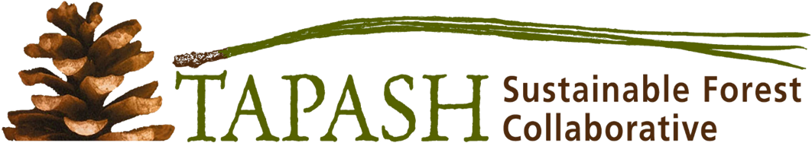
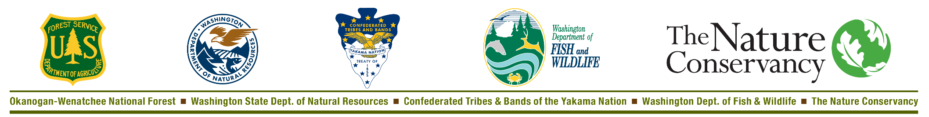
The Tapash executive board is comprised of 5 Decision Makers who represent 5 major landowners in the central Washington Cascades.
US Forest Service: Jason Kuiken
WA Dept. of Natural Resources: Larry Leach
Yakama Nation: Steve Andringa
WA Dept. of Fish and Wildlife: Scott McCorquodale
The Nature Conservancy: James Schroeder

Slide 4

Why is there a concern about forests in central Washington?
What events triggered the formation of Tapash?
Where is the Tapash landscape?
Our mission and how we are organized.
How we are accomplishing our goals.
Collaborating with collaboratives.

Slide 5
DNR Forest Health Report 2014
Notes:
In the central Cascades, due to A COMPLEX VARIIETY OF ISSUES THERE IS A BIG CONCERN FOR THE HEALTH OF OUR FORESTS. A BIG FACTOR IS 100 years of fire suppression, compounded by climate change, has caused the frequency and severity of insect and disease infestations….

Slide 6
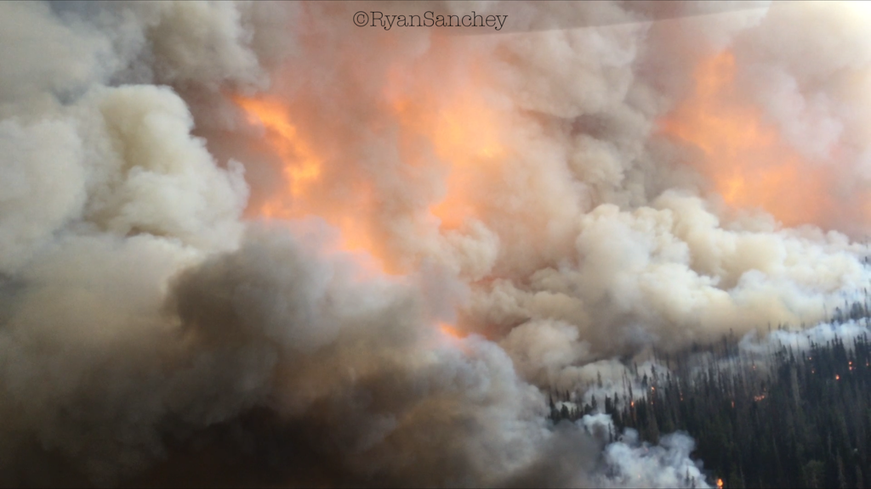
2015 Cougar Creek Fire - 55,000 Ac
Yakama Reservation
Notes:
…. and the frequency and severity of catastrophic wildfires to reach unprecedented levels.

Slide 7
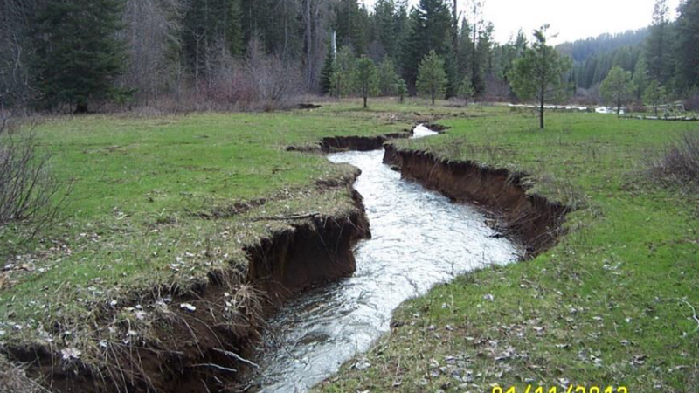
Photo courtesy of Scott Nicolai
Yakama Nation Fisheries
Notes:
In addition, degraded riparian corridors and floodplains are impacting threatened salmonids and other aquatic species. Indian creek, trib to NF Teanaway

Slide 8
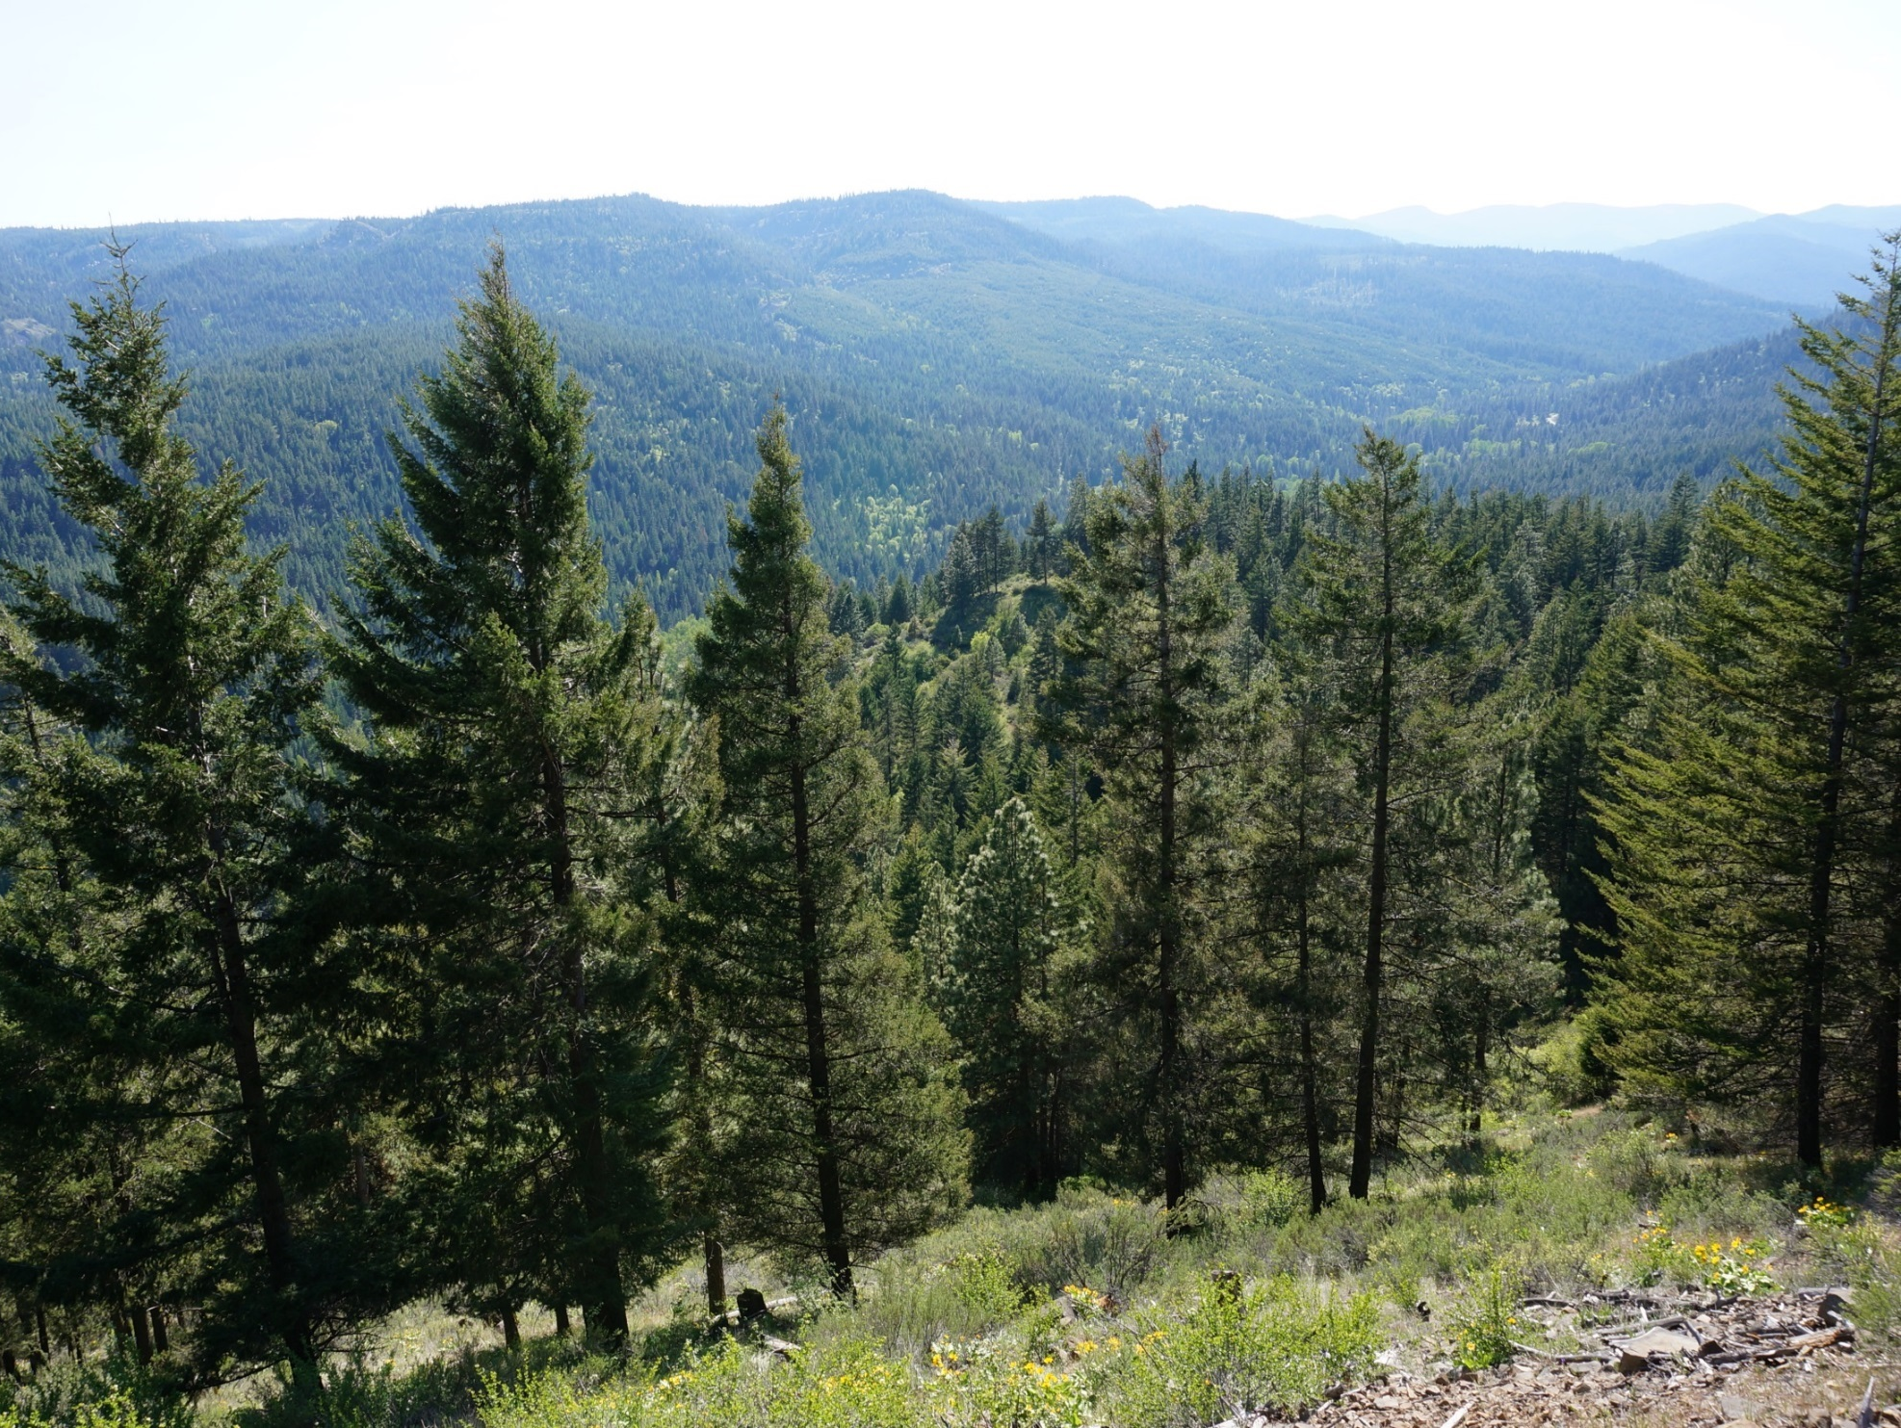
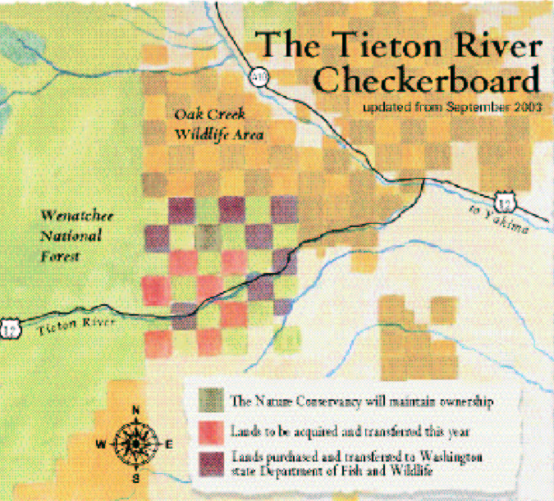
A brief history of the Collaborative…
Notes:
In the early 2000’s, vast tracts of forested land held in private ownership were at risk of conversion to non-forested habitat.

Slide 9
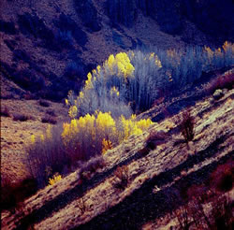
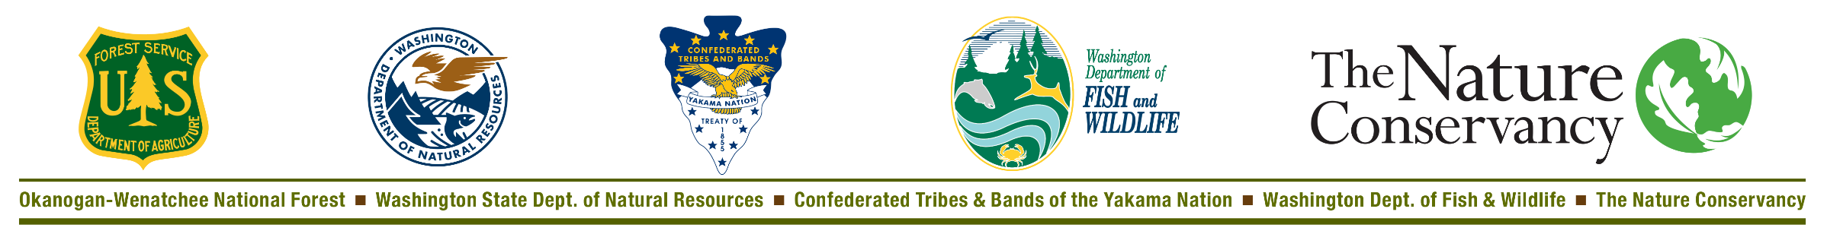
2003: TNC and Rocky Mountain Elk Foundation work together to purchase over 10,000 acres in Tieton Canyon from Plum Creek Timber
2006: TNC collaborates with WDFW to transfer all but 640 acres to WDFW Oak Creek Wildlife Area.
2007: Tieton Conservation Action Plan (CAP) sessions lead
to memorandum of understanding that facilitates land managers to work together across ownership boundaries
2007-2008: The Tieton Collaborative expands its scope to include the Yakama Nation and is renamed the Tapash Sustainable Forest Collaborative
Notes:
The executive board members are comprised of decision makers representing: US Forest Service, WA State Dept of Natural Resources, Yakama Nation, WA State Dept of Fish and Wildlife, and The Nature Conservancy

Slide 10
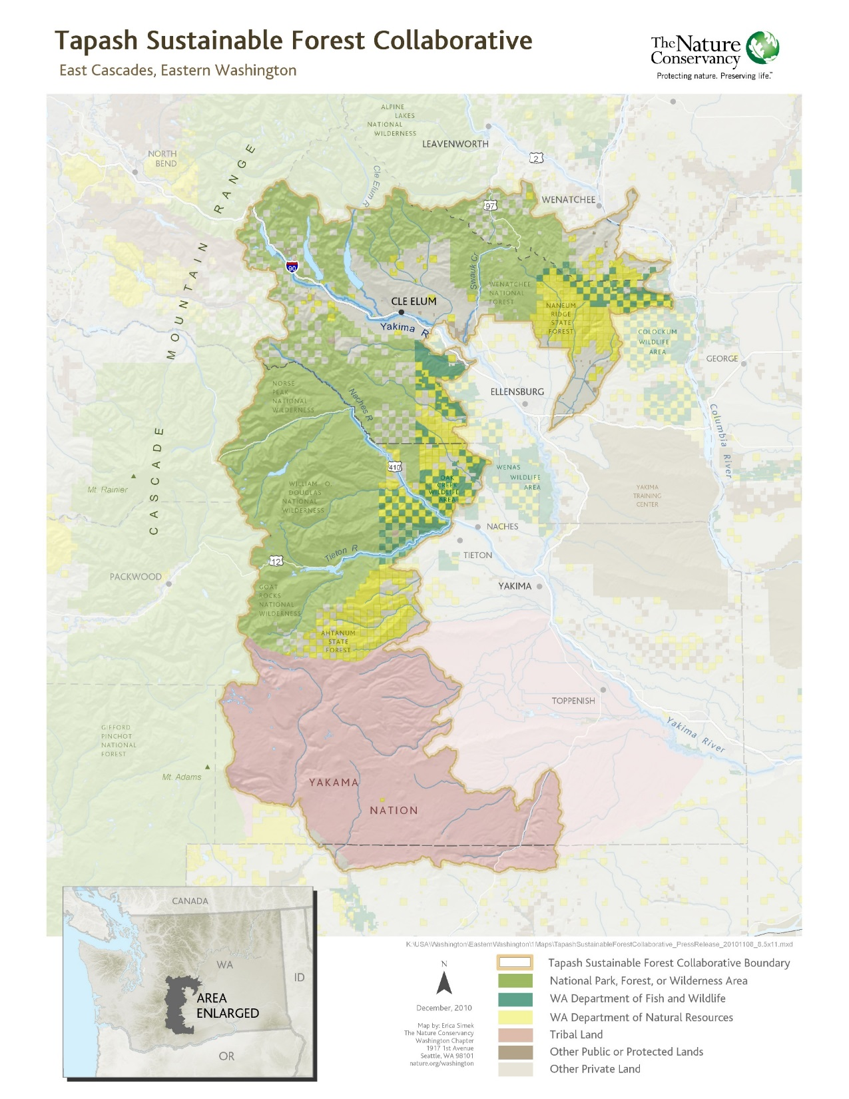
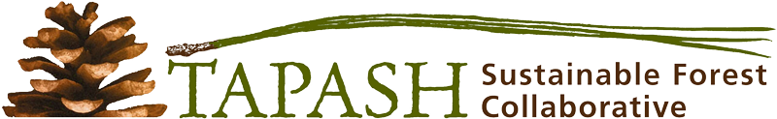
Notes:
Tapash landscape now covers 2.3 million acres, from Yakama nation in the south all the way north to around Blewett Pass

Slide 11
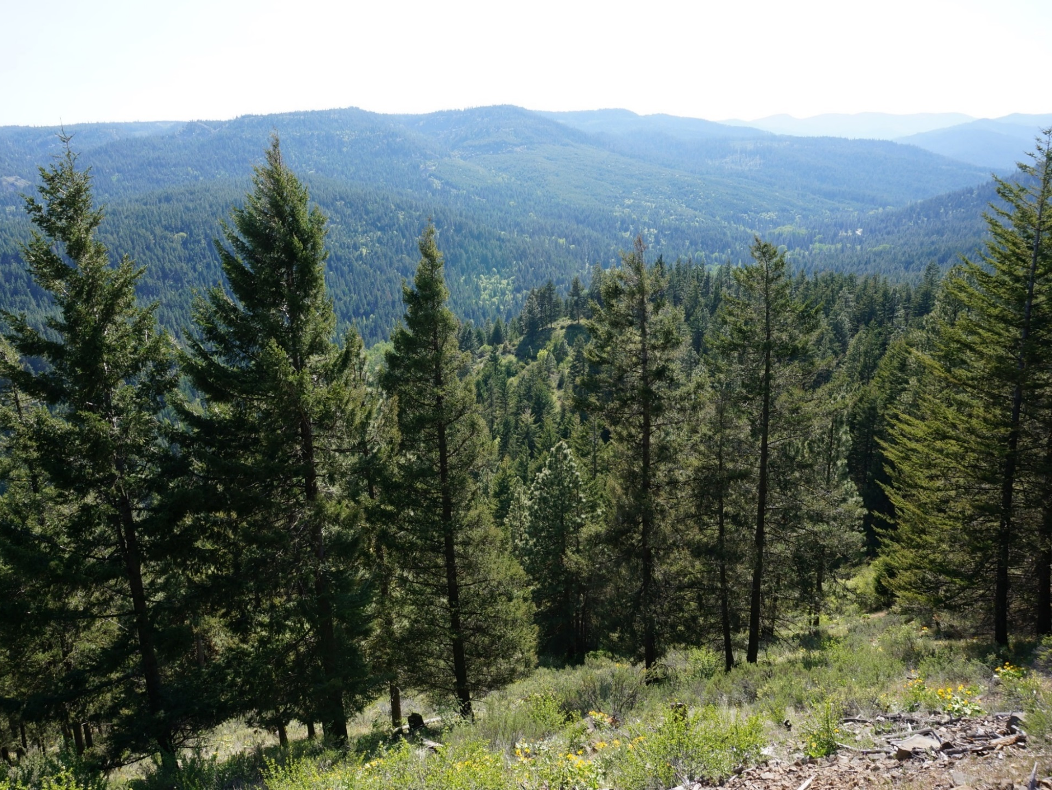
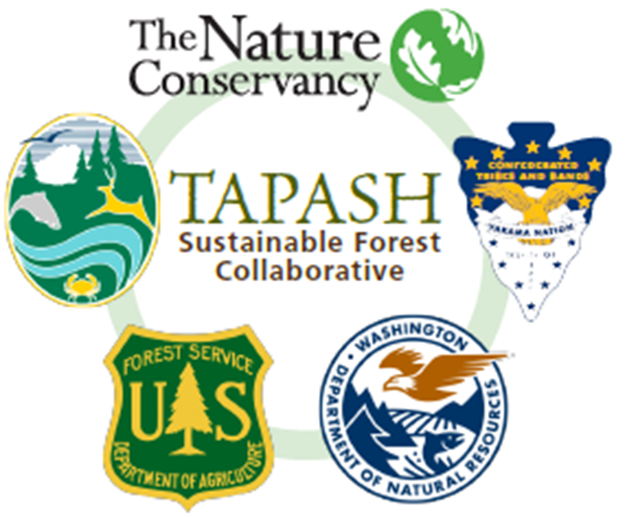
Tapash Sustainable Forest Collaborative
is working “to improve ecosystem health and natural functions of the landscape through active restoration projects backed by the best available science, community input, and
adaptive management”
Notes:
Tapash strategic priorities focus on large landscape restoration projects.

Slide 12
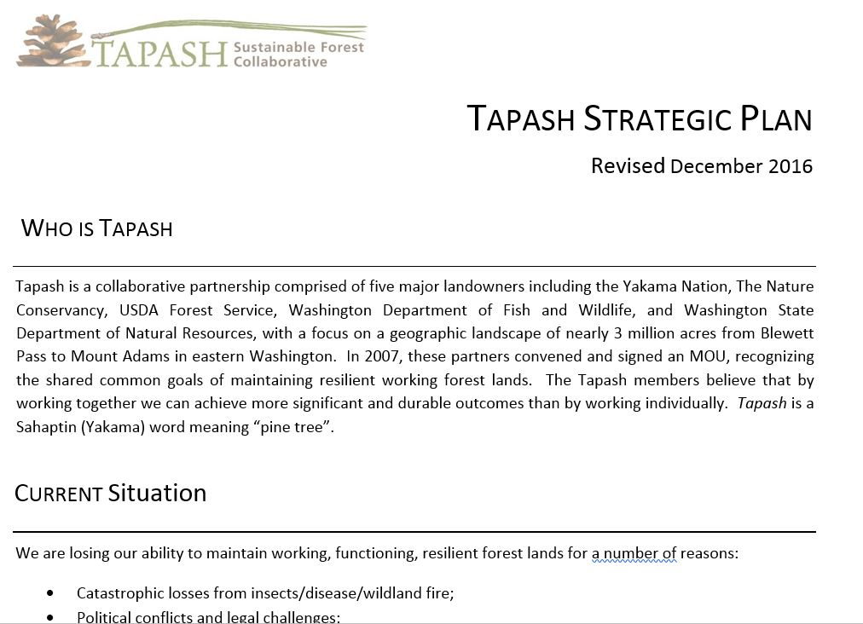
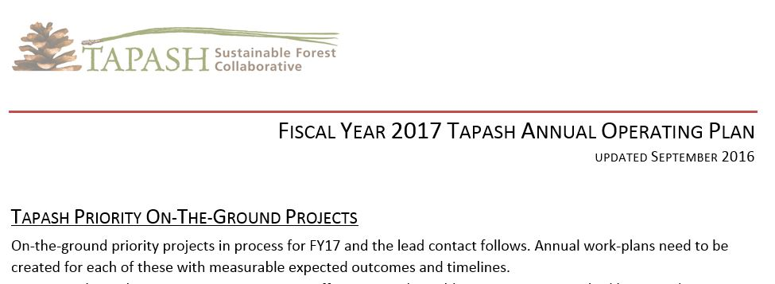

Slide 13
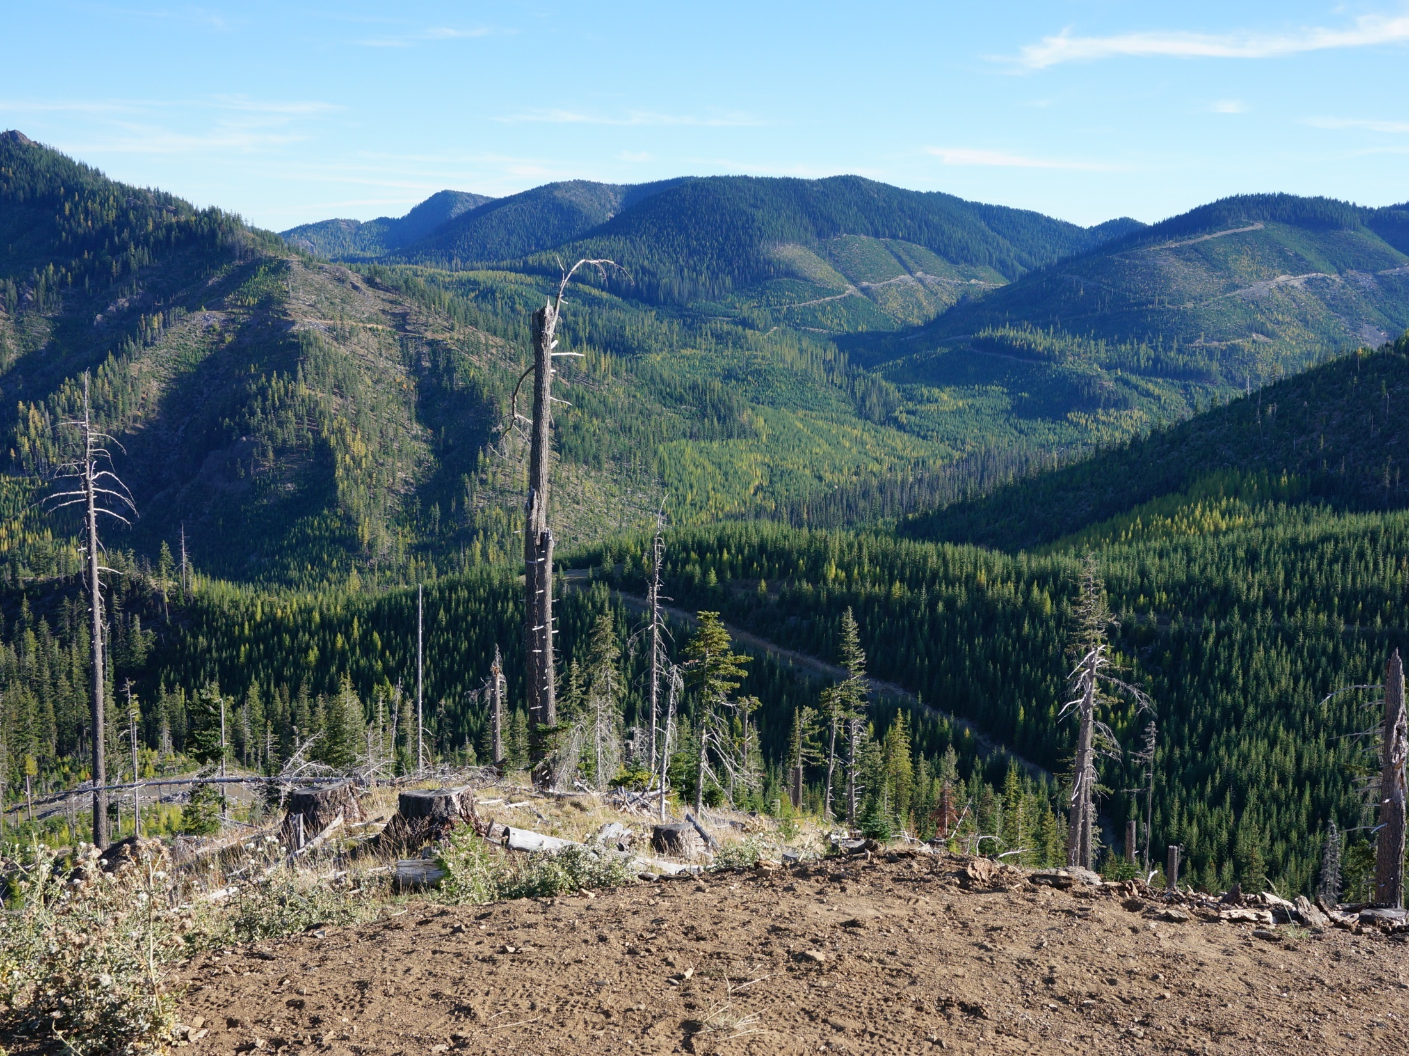
Terrestrial Landscape Evaluation
Aquatic
Landscape
Evaluation
Terr. Landscape Rx
Aquatic Landscape Rx
Integrated Project Pipeline
Notes:
To address these concerns, Tapash works with a variety of partners to develop and implement large-scale restoration projects than span multiple ownerships

Slide 14
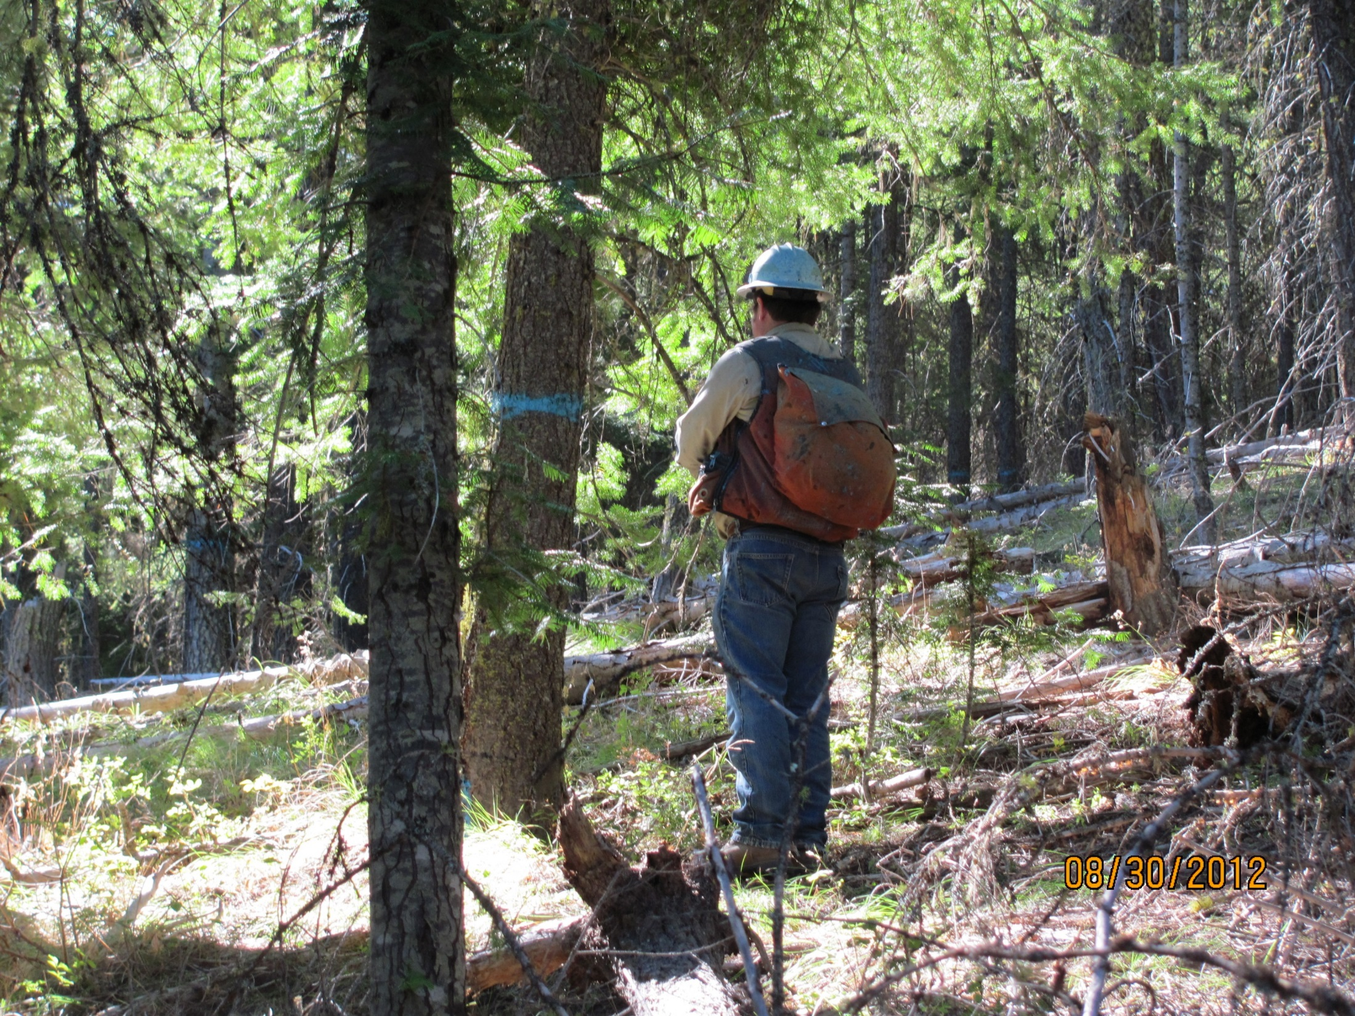
Notes:
Including commercial thinning overstocked stands, often followed with prescribed fire

Slide 15
Fuel Reduction Thinning Results. Before (left) and after (right) fuel reduction thinning.
Eastern Washington Forest Health: Hazards, Accomplishments and Restoration Strategy. A Report to the Washington State Legislature. October 2014
Notes:
Before and after thinning

Slide 16
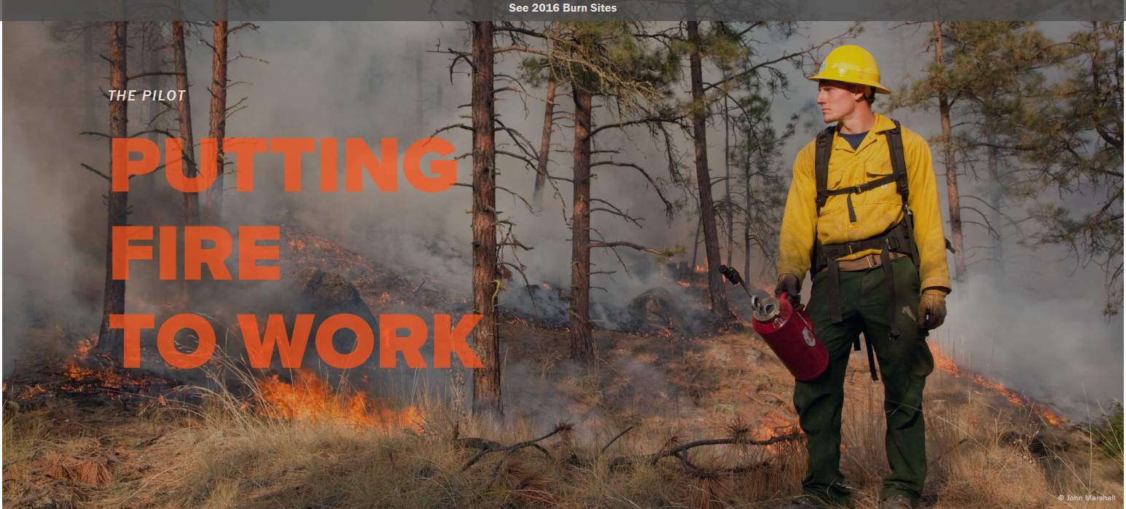
In the Spring of 2016, the Washington State Legislature passed
House Bill 2928, the Forest Resiliency Burning Pilot project.
Prescribed fire is professional fire — don't try it at home
Notes:
often followed with prescribed fire PRESRCIBED BURN

Slide 17
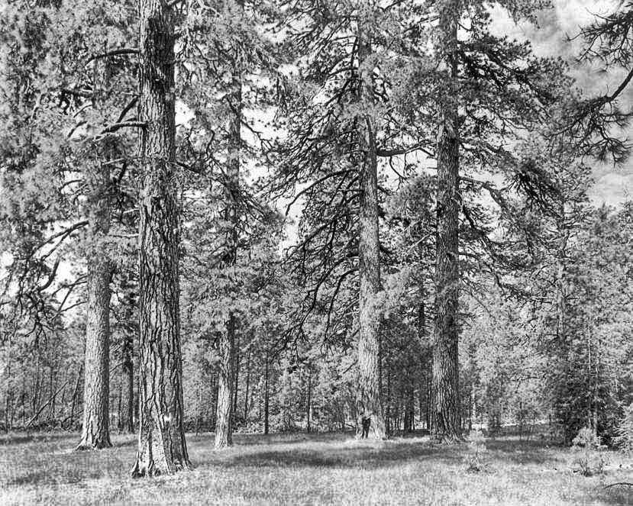
Notes:
To move closer to within the range of natural variability before the era of fire suppression and when there was more active management of the forest by native tribes

Slide 18
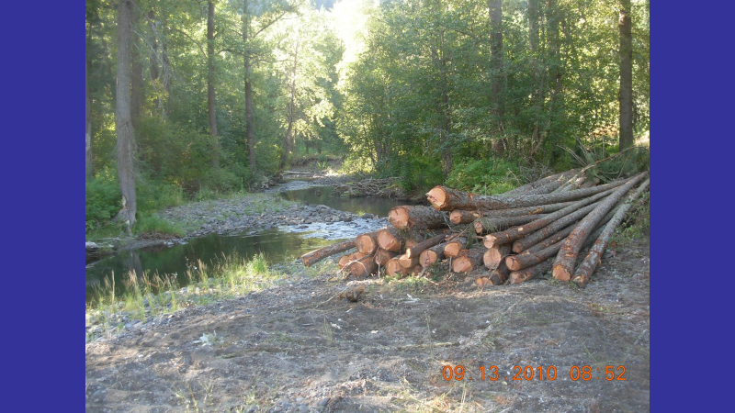
Notes:
ALSO trees harvested during commercial thins can be used for riparian treatments, within the Tapash landscape most of this work has been done by Yakima fisheries on their ceded lands owned by WA Dept of Fish and Wildlife

Slide 19
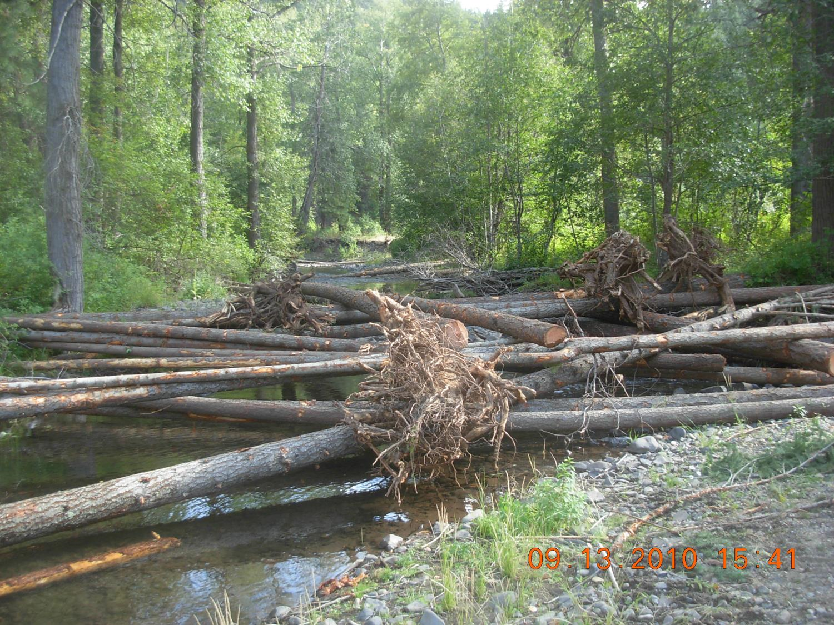

Slide 20
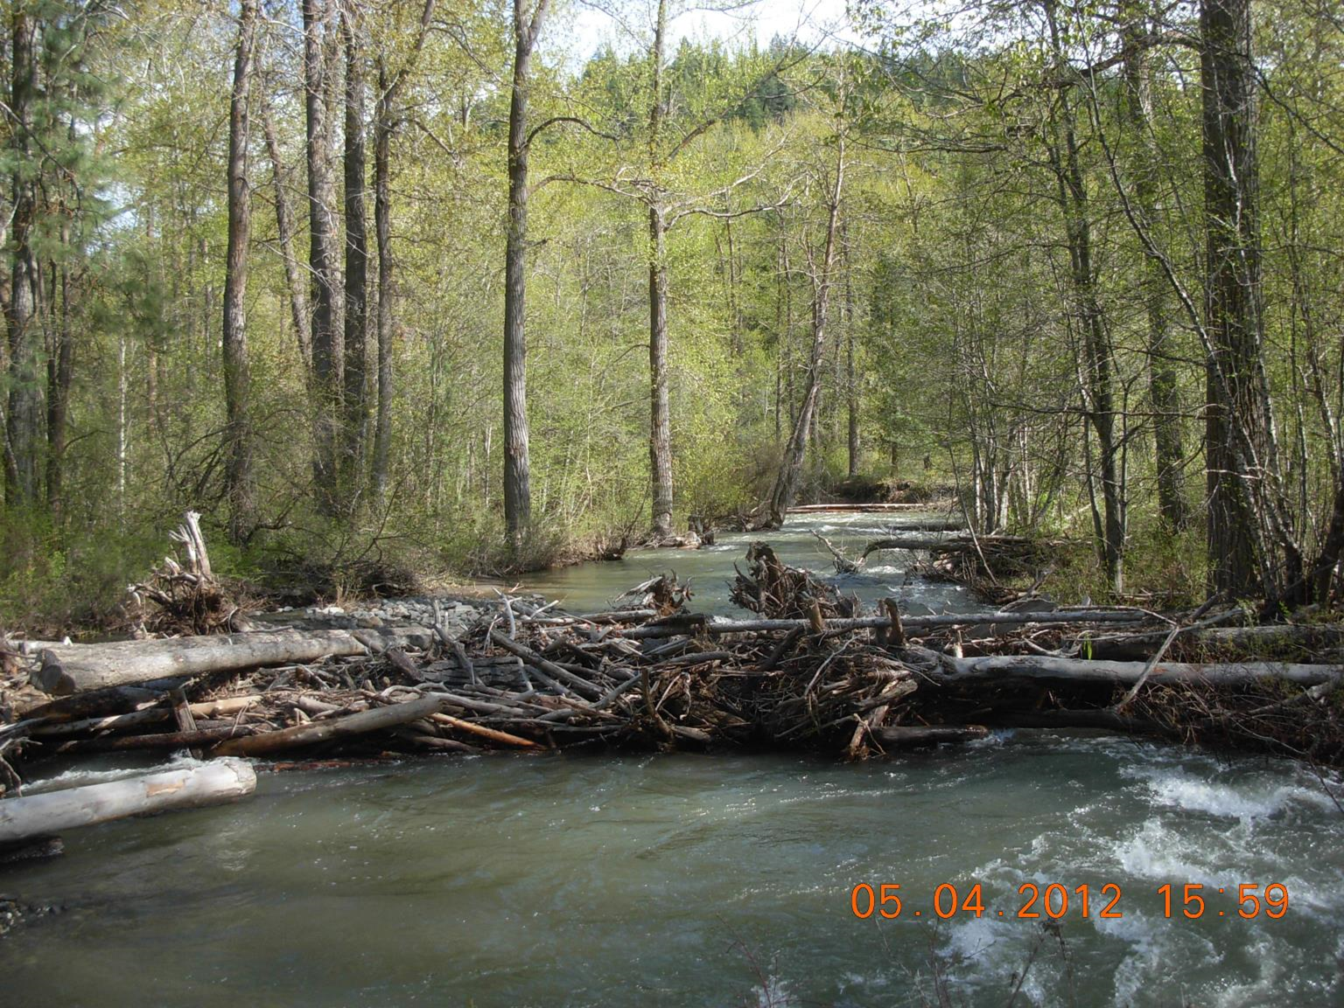
Same site, after a ~100 year flood.

Slide 21
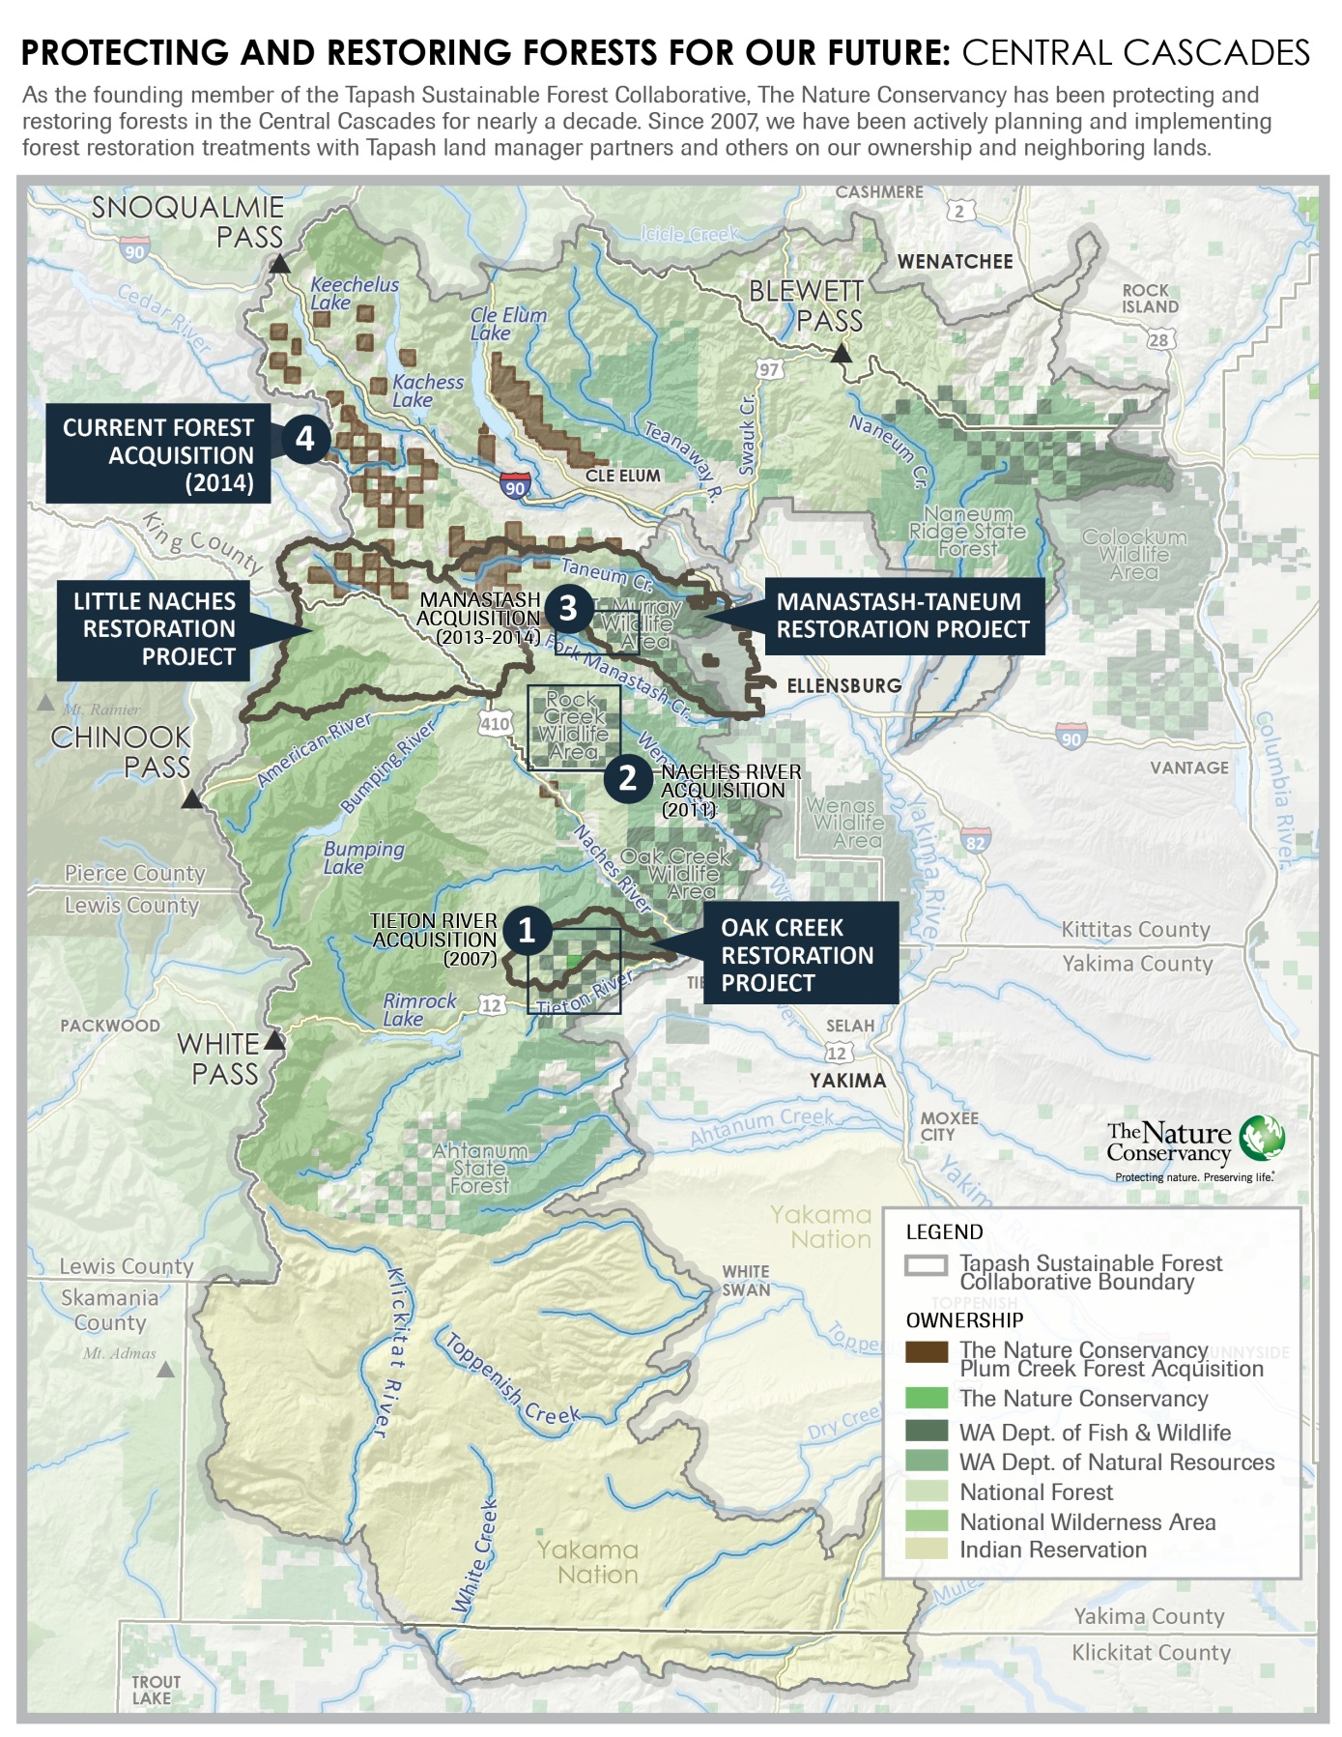
5. DRY STEWARDSHIP PROJECT
Notes:
Tapash decides on focal strategic priorities annually that include large landscape restoration priorities.
In 2007 Oak Creek was identified as the first identified Tapash restoration landscape, 35,000 acres of FS, DFW, DNR and TNC lands . An Oak Creek Restoration Project update 2 pager providing background and restoration accomplishment updates for this fiscal year is available for those attending this session in person, and I can provide to others calling in after today’s meeting.
From lessons learned from shared work in the Oak Creek Restoration Project, in 2014 Tapash moved forward in identifying additional sub-landscapes to focus results in.

Slide 22
Notes:
Tapash partners have accomplished the consolidation of over 246,179 acres of land since formation of the Collaborative in 2007!

Slide 23
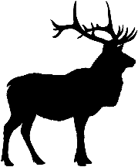
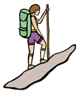
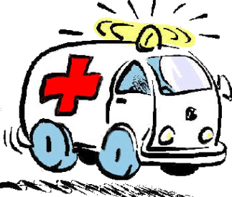
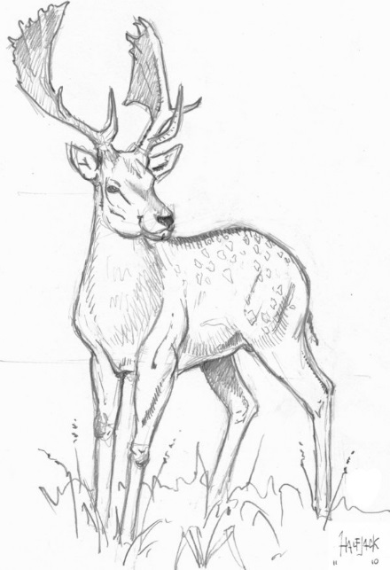
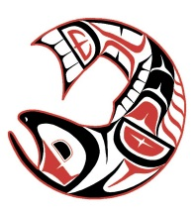
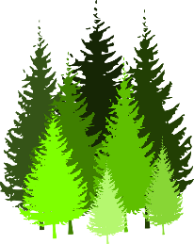
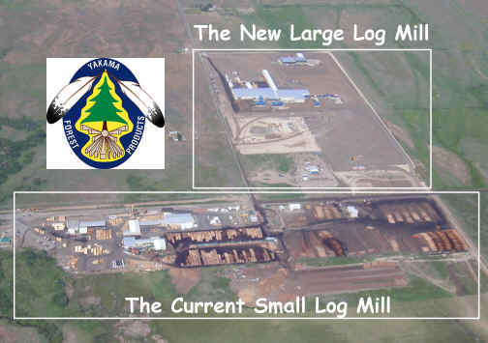
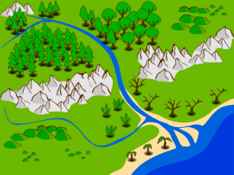
Outcomes of Tapash cross-boundary management
Increased connectivity
Better linkage
Quicker response
Coordinated enhancement efforts
More cost effective
Consistent management
Tapash supports “Working Forests” to help build strong communities
Notes:
Increased connectivity for wildlife migration
Better linkage of roads and recreational trails
Quicker response to wildfires and other cross-boundary emergencies
Improved enhancement of habitat for salmon and other migratory fish
More cost effective timber sales and invasive species prevention; treat the forest with similar silvicultural practices
Consistent management of river corridors and cross-boundary wetlands

Slide 24
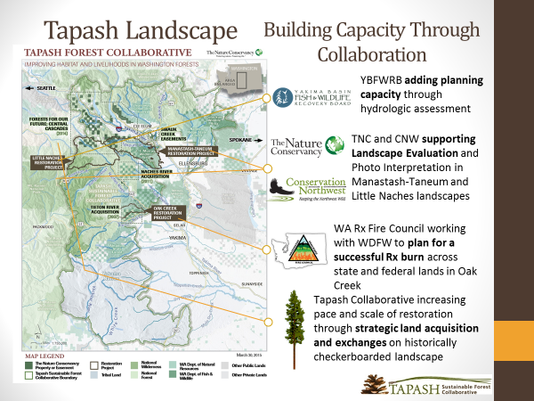

Slide 25
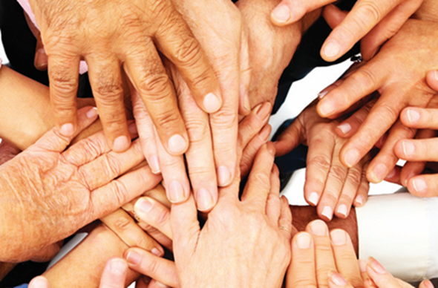
Washington State Forest Collaboratives
Tapash Sustainable Forest Collaborative
Northeast Washington Forestry Collaborative
North Central Washington Forest Health Collaborative
Chumstick Wildfire Stewardship Coalition
Pinchot Partners
South Gifford Pinchot
Darrington Forest Collaborative
Olympic Forest Collaborative
Notes:
WE HELP EACH OTHER AND SHARE INFORMATION

Slide 26


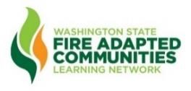
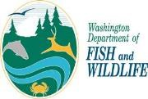



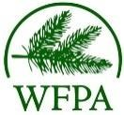
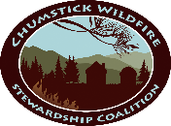
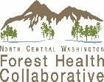
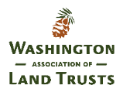
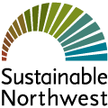
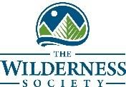

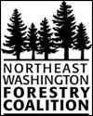
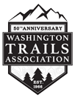





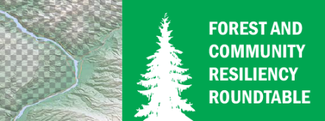
The Forest and Community Roundtable is a diverse group of stakeholders and governments who have come together to advocate for investment in locally driven large landscape forest restoration and community preparedness projects that further our shared goals for improving the resilience of Washington’s communities and forests
Darrington
Collaborative
Olympic Forest
Collaborative

Slide 27
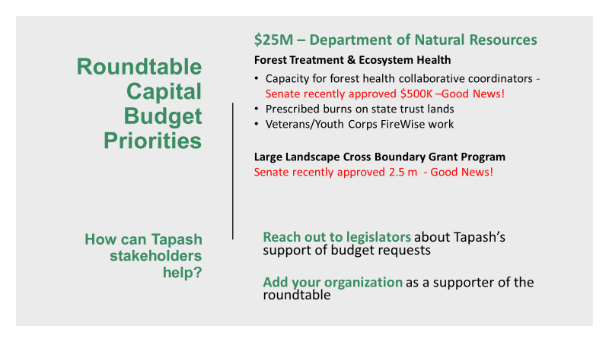

Slide 28
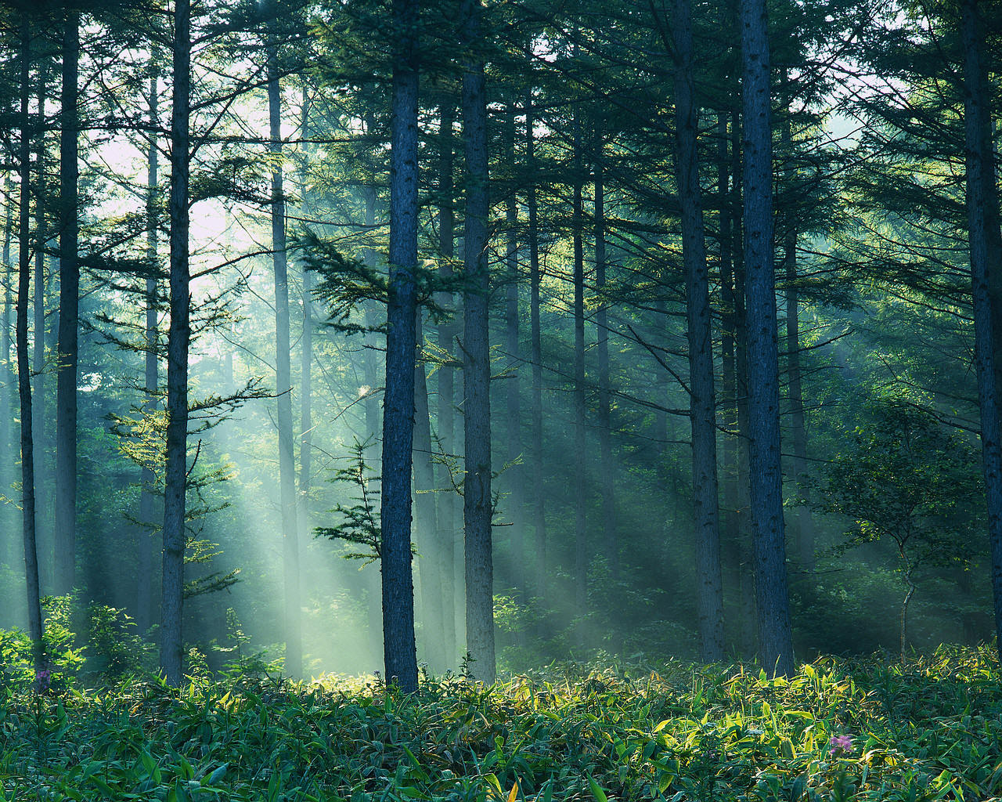
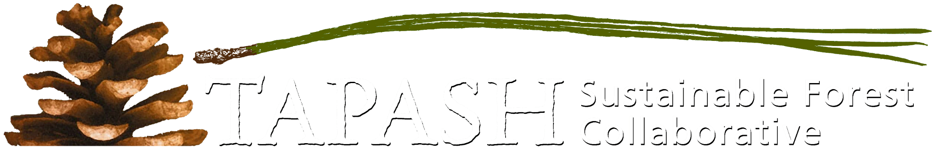






Anchor Forests:
More Than Trees
Protecting our
People, Places, Communities

Slide 29
laura.potash@tnc.org
206-678-7866
www.tapash.org

